Slide 1
Securing the Satellite Software Stack
Samuel Jero, Juliana Furgala, Max A Heller, Benjamin Nahill, Samuel Mergendahl, and Richard Skowyra
SpaceSec Workshop 2024
March 1, 2024
DISTRIBUTION STATEMENT A. Approved for public release. Distribution is unlimited. This material is based upon work supported under Air Force Contract No. FA8702-15-D-0001. Any opinions, findings, conclusions or recommendations expressed in this material are those of the author(s) and do not necessarily reflect the views of the U.S. Air Force. © 2024 Massachusetts Institute of Technology. Delivered to the U.S. Government with Unlimited Rights, as defined in DFARS Part 252.227-7013 or 7014 (Feb 2014). Notwithstanding any copyright notice, U.S. Government rights in this work are defined by DFARS 252.227-7013 or DFARS 252.227-7014 as detailed above. Use of this work other than as specifically authorized by the U.S. Government may violate any copyrights that exist in this work.
Notes:
Good morning, my name is Samuel Jero and I’m a member of technical staff at MIT Lincoln Laboratory. Today, I’m going to be presenting our work “Securing the Satellite Software Stack”. I should note that this is joint work with my colleagues Juliana Furgala, Max Heller, Ben Nahill, Samuel Mergendahl, and Rick Skowyra. This work seeks to motivate further research into methods of securing the software running on satellites by highlighting a number of unique challenges to security for these systems.

Slide 2


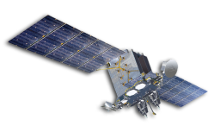
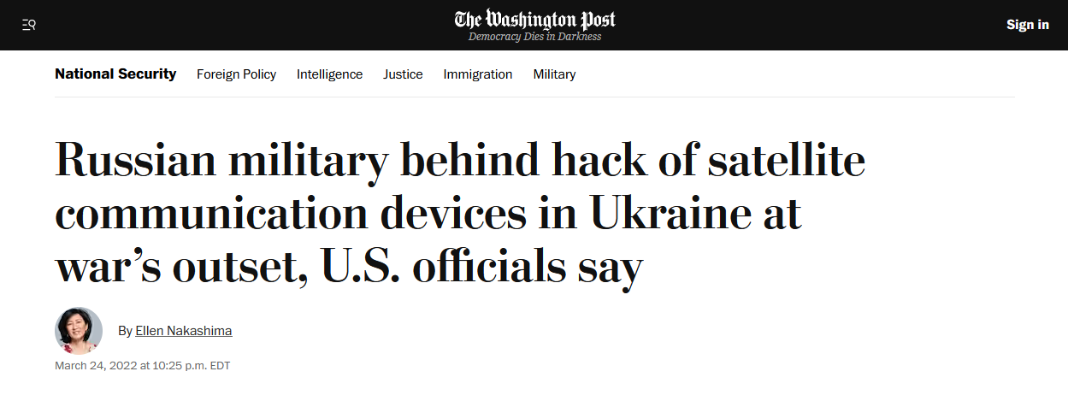
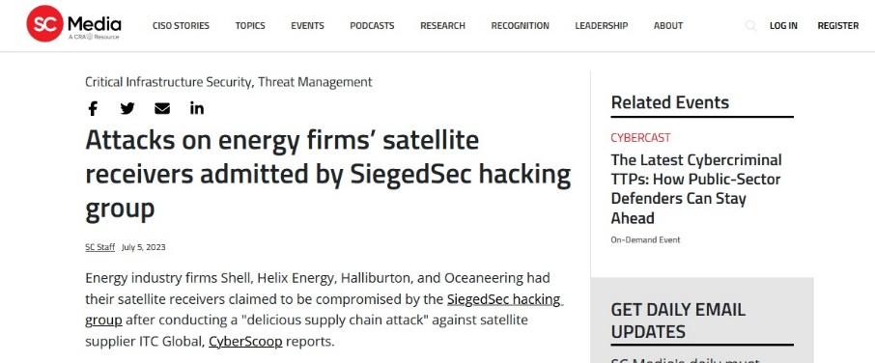


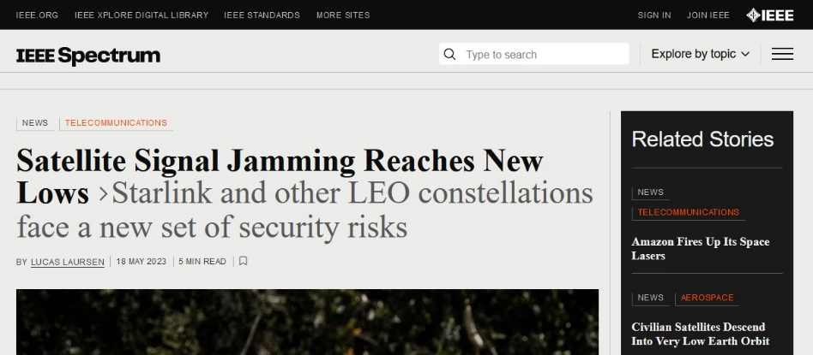
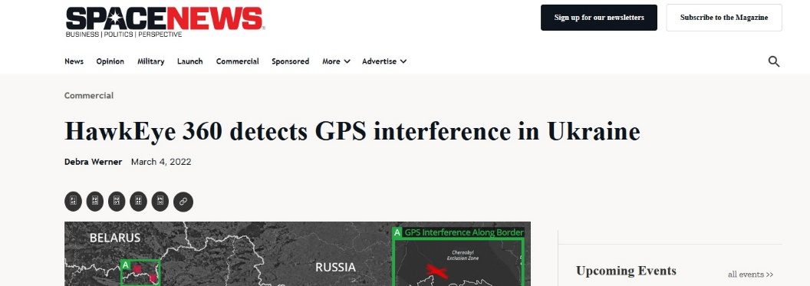
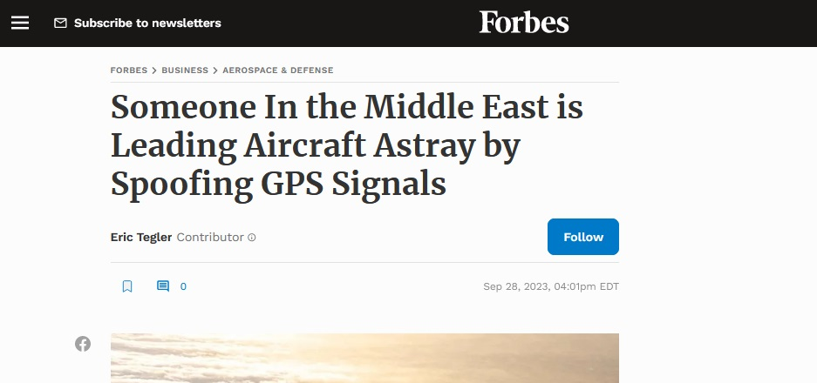
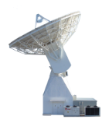
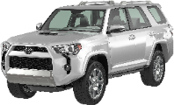
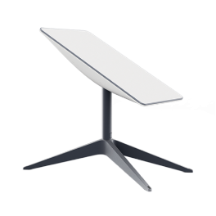
Satellite Systems are Increasingly Under Attack
Communication
GPS
Weather
Imaging
Satellite Internet
Notes:
We’re at a workshop on Satellite Security, so I probably don’t have to convince all of you that satellite systems are extremely important to the modern world. GPS alone has transformed the modern world, enabling position and navigation for so many systems and providing precise timing for many others. Satellite imaging has been similarly transformative, especially for weather forecasting. Satellites have made communication anywhere on the globe possible, from traditional Satellite Radios for use in areas where terrestrial infrastructure is non-existent or destroyed, to constellations providing Satellite Internet with responsive latency to rural areas.
Yet, probably because of the critical nature Satellites play in society, we are increasingly seeing these satellite systems come under attack. From Russia’s hack of the Viasat satellite network, immediately prior to their invasion of ukrane, to massive GPS interference in active war zones, spoofing GPS signals over the Middle East, Jamming Starlink and other communication satellite systems, and hacking satellite receivers used by energy firms, we are seeing these systems increasingly targeted by attackers, often motivated, well-resourced, nation states. To counter these attacks, work on the security of these systems is clearly required.

Slide 3
Security Focuses for Satellite Systems
Encryption and Authentication of Communication Links
Historical emphasis of security for satellite systems
Security of Analog Sensors and Signal Spoofing/Jamming
Anti-jamming efforts for communication satellites
Spoofing sensor signals either on- or off- satellite
Frameworks for modeling threats on satellite systems
Aerospace’s Space Attack Research & Tactic Analysis (SPARTA) framework
Work highlighting the need for classic software security in satellite systems
Calling for memory safety and designing software with security and reliability in mind
Notes:
Let’s start by considering where work on security for satellites has traditionally focused. Historically, much of the emphasis on security has been on encrypting and authentication command and control links with the ground. Rigorous security here has been common for some classes of satellites, especially military ones. However, other commercial systems have only recently realized that obfuscation is insufficient, especially for customer traffic.
Another major theme of prior security work on satellites has been signal spoofing/jamming and analog sensor concerns. This is especially the case for PNT systems like GPS and for communication satellites, where the primary goal is communication. The literature on anti-jam techniques is rich. However, there’s also been work looking at attempts to spoof analog signals from a satellites sensors and exploring the impact that could have, including last year at SpaceSec.
Another area of focus for satellite security has been modeling threats to satellite systems. Aerospace’s Space Attack Research & Tactic Analysis or SPARTA framework is just one such framework that’s been developed.
Finally, a particularly interesting recent development is work highlighting the need for classic software security protections in satellite software. This work emphasizes things like separation of concerns, least privilege, memory safety, careful consideration of all layers of the software stack, and really everything the security community has learned over the last several decades. This thrust of work is interesting, but leaves us asking a profoundly important question…

Slide 4
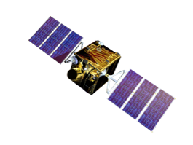

Does Satellite Software Deserve Special Attention by the Security Community?
Or: Is a Satellite really any different than any other Embedded Device?
Lack of Accessibility
Emphasis on Safety and Availability
Radiation Faults
Legacy Software
Payload/Mission Software
System Control Software
Platform Support (e.g., drivers, HW configuration)
Operating System
Onboard Computer
Special Hardware
These Challenges pose unique issues for securing satellite systems
Notes:
Does Satellite Software deserve special attention by the security community? Or put another way, is a satellite really different from any other embedded device? After all, from at least one perspective a satellite is essentially just an embedded system. Here you see the components of a typical satellite, with mission software and platform support running on some real-time operating system on an onboard computer, controlling specialized hardware. Essentially, this is just a fancy embedded device, and the security community has already extensively studied embedded devices.
However, We argue that satellite software faces a number of key challenges not seen in terrestrial systems. These challenges include, first, the sheer remoteness of these systems and, hence, there effective lack of accessibility once launched. Second, the emphasis of these systems on safety and availability instead of the more common security concerns of confidentiality, integrity, and availability. Third, the harsh radiation environment that satellites operate in making radiation-induced faults not a ghost-in-the-machine event but a guaranteed occurrence that must be effectively dealt with and mitigated. Finally, the complexity of these systems and number of integration units means that, except for possibly the smallest cubsats, we will have legacy software on these systems to deal with and interoperate with.
We argue that these challenges pose unique issues for securing satellite systems and deserve focused research by the security community and hope to encourage interest and research in these topics. Due to time constraints, we will not be discussing legacy software further in this presentation.

Slide 5

Outline
Motivation
Challenges
Research Directions
Summary
Notes:
Okay. So far we have covered the motivation for our work. We’re now going to briefly discuss some important considerations for cyber threats to satellites before discussing the first three of our challenges in more detail. Then, I’ll present a vision for a future secure satellite software stack and key research directions to get there. Finally, we’ll conclude with a summary.

Slide 6
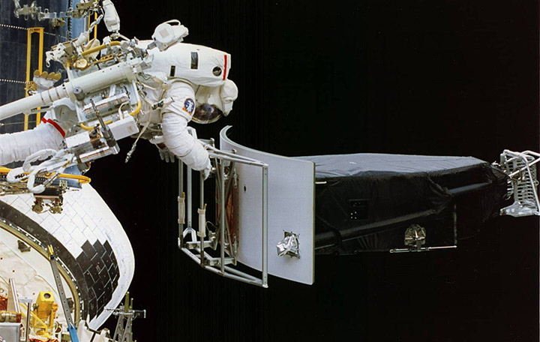
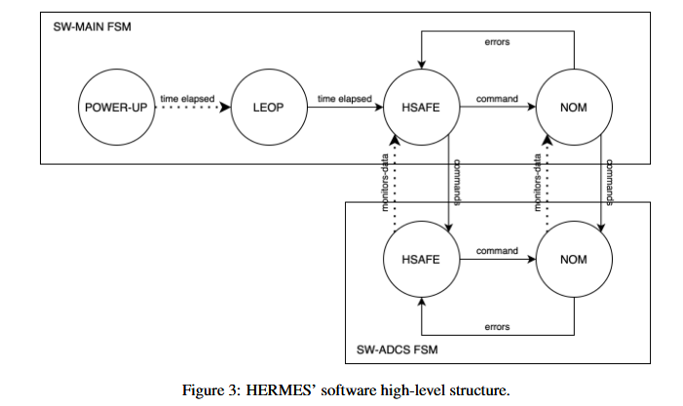
Challenge: Lack of Accessibility
Satellites are effectively inaccessible after launch
No way to walk up and reboot or reimage
Software must remain operational enough for operator to access, diagnose, and fix problems
Current solutions
safe modes built into the satellite’s state machine
Fall-back system images
These are focused on environmental or hardware faults
Not sufficient against malicious attackers
If attacker gains code execution, they can prevent safe modes or reboots
Need isolated, independent component to be able to reassert control
Image From: https://hubblesite.org/files/live/sites/hubble/files/home/mission-and-telescope/servicing-missions/_images/telescope_team_sm1_1_lg.jpg
Image From: Piccinin, Margherita, et al. "A finite state machine approach to nano-satellite SW design: the HERMES case study."
Aerospace Europe Conference 2023-Joint 10th EUCASS-9th CEAS Conference. 2023.
Notes:
The first major challenge that makes satellite software unique is the sheer lack of accessibility of these systems. Unlike a terrestrial system where, in the worst case, an operator can walk up to it and reboot or reimage it. In space this is effectively impossible. Once the satellite is launched it is effectively inaccessible. Accessibility after that point would require a dedicated mission with either astronauts or fancy robotics on board. To the best of my knowledge, NASA’s missions to repair the Hubble telescope are the only example of this to date. So unless your mission has similar visibility and impact, once its launched that’s it.
The major implication of this is that the satellite’s software must remain operational enough to enable the operator to access, diagnose and fix problems remotely. To deal with this challenge today, satellites often use safe modes and fall-back system images. A safe mode is a mode of operation built into the normal satellite software. When some error or unexpected condition occurs, the software enters this safe mode, where the goal is simplicity, safety, and accessibility: the satellite will typically point its solar panels at the sun to stay power positive, point its antenna at earth to enable communication with operators, and turn off non-critical components and payloads. Similarly, fall-back system images are additional boot images, sometimes called golden images, that the satellite can boot if primary images fail or an image update fails. Again, the goal of these images is to ensure that the satellite comes back up again.
Unfortunately, these approaches are focused on dealing with faults caused by environmental factors, especially radiation, or hardware faults and are simply insufficient to protect against malicious attackers. In particular, safe modes are usually built as special modes within the normal satellite control software, as illustrated in the figure on the lower right. Hence, if the attacker exploits this software and gains execution, they can ignore or bypass the included safe modes. Similarly, fall-back system images exist to ensure that a satellite that is rebooted comes back up. If an attacker can prevent the system from rebooting, they can render the fall-back system images useless.
Ultimately, dealing with malicous attackers requires some isolated, independent component of the system. This component must not be compromised and must have the ability to reassert control over the rest of the satellite.

Slide 7
Challenge: Safety and Availability
Satellites
Traditional Security Approaches
Safety
Confidentiality
Availability
Integrity
Decreasing Importance
Integrity
Availability
Confidentiality
“Crash the system” is simply not an acceptable solution to security issues
“Log and ignore” isn’t much better
Notes:
The second major challenge to satellite software is an overriding emphasis on safety and availability. Of most importance for satelliting systems is preserving the safety of the satellite so as to not inflict permanent damage on it, by say pointing a camera at the sun, and also not damaging other satellites and potentially sparking a Kessler syndrome scenario. After that comes availability, as that is needed both to preserve safety and to enable the ground to continue to control the satellite. Once those two requirements are ensured, then satellite operators are concerned with the integrity of the systems and their data, ensuring that satellites are operating uncorrupted software and sending uncorrupted data. Finally, confidentiality, at least within the satellite, takes a distant last place.
Observe that this is in sharp contrast to the emphasis of traditional security guarantees, where confidentiality is of primary importance: whatever happens don’t leak data, followed by integrity, and last of all availability. Not only is the order here exactly reversed, but safety doesn’t even figure in our traditional list!
One practical example of this mismatch occurs in security tools like stack canaries and CFI. These, and many other tools, operate by detecting exploits and then crashing the process. Implicitly this is an assumption that confidentiality and integrity are more important than availability. Or at very least, that having the process be restarted is both sufficient and timely enough to be acceptable. The other approach often used in operations of log and do nothing, doesn’t disrupt availability but still allows the exploit to occur. We’ll return to this challenge later when we talk about research directions, because we really need other options here.

Slide 8
Challenge: Radiation Faults
Cosmic radiation regularly induces faults in satellite systems
Extensive effects on software, no reliable detection method
Current solutions
Error correcting caches and memory
Hardware memory scrubbers
Memory protection (MMUs and MPUs)
Watchdog timers
Experimental characterization of error rates and impacts
How does Radiation impact Security Guarantees?
How do you isolate parts of the system, when critical software may suffer arbitrary faults?
Is process isolation actually reliable in the face of radiation faults?
Is MMU/MPU-based isolation actually reliable in the face of radiation faults?
Notes:
The final challenge we’ll talk about today is radiation faults. Satellites operate in a harsh environment filled with cosmic radiation that terrestrial systems don’t have to deal with. When these high-energy particles hit computer chips, they disrupt stored data and computation. The impact of this corruption on software can be complex and extensive, especially after propagating during continued execution. Today we have no reliable detection mechanism for these events.
Current solutions for this challenge largely focus on detecting errors where we can in hardware, using error correcting memory and scrubbers, recovering from completely incorrect operation, using memory protection and watchdog timers, and characterizing the frequency and impact of these faults. Although these are helpful solutions, they still allow incorrect execution to continue for potentially significant lengths of time.
For software trying to provide security guarantees this is a major challenge. For instance, how do you guarantee isolation when a radiation fault could cause a data page from one process to be mapped into another process? Is this likely to happen? How likely? What other failures of isolation exist when critical software may suffer arbitrary faults? Answering these questions is crucial to understanding the operation of security software on satellites and the guarantees that will actually be provided. Having now covered some of the core challenges to satellite software, lets turn to look at the future.

Slide 9
A Vision for the Future: Secure Satellite Software
Fault Recovery
Interoperability with Legacy Code
Assurance Technologies
Root of Recovery
Payload/Mission Software
System Control Software
Platform Support (e.g., drivers, HW configuration)
Operating System
Isolated, Modular Systems
Onboard Computer
Characterization of Radiation Faults
Special Hardware
Significant, Sustained Research Required
Notes:
So far we’ve looked at a lot of major challenges to security in satellite systems. However, this is not a doom and gloom talk. We are deeply hopeful for a future where satellite software is secure and correctly handles the challenges we’ve just discussed. However, in order to reach such a future research is required on a broad array of topics. We see five areas in particular as need significant research. These are isolated, modular systems to enable containing attackers and faults within small segments of the system, assurance technologies to develop high assurance in the correctness of satellite software, fault recovery to consider how to recovery from attacks and faults, characterization of radiation faults, and interoperability with legacy code to enable gradual deployment.
Over the next few slides we’ll cover all of these in more detail, except for interoperability with legacy code, which we omit due to time constraints.

Slide 10

Research Direction: Isolated, Modular Systems
Isolation is critical for dealing with malicious attackers, who:
try to move between components
try to resist recovery
try to co-opt the system
Effective in combination with:
Least privilege to limit the privileges an attacker gets from a single component
Separation of privilege to require an attacker to compromise multiple components
Monolithic Software
Isolated, Modular Software
Component 1
Component 2
Component 1
Component 2
Component 3
Component 4
Component 3
Component 4
Component 5
Component 6
Component 5
Component 6
Despite these principles being nearly 50 years old, we still struggle to build systems in this manner effectively
Notes:
The first major research direction we see as important for satellite systems is Isolated, Modular systems. This is really important because isolation is critical for dealing with malicious attackers who try to move between components, resist recovery, or co-opt the system. This is because isolation limits the attacker to a single part of the system and ensures that there are other parts of the system to reassert control. This is of course most effective with least privilege and separation of privilege to ensure that there is actually more than one component in the system. Note that many of these ideas aren’t new; in fact, many of these principles are nearly 50 years old. However, we still struggle to build systems in this manner effectively, especially for embedded systems. And this is both a pragmatic challenge as well as a research challenge, because building a system in this manner opens up a lot of tricky design and research issues.

Slide 11
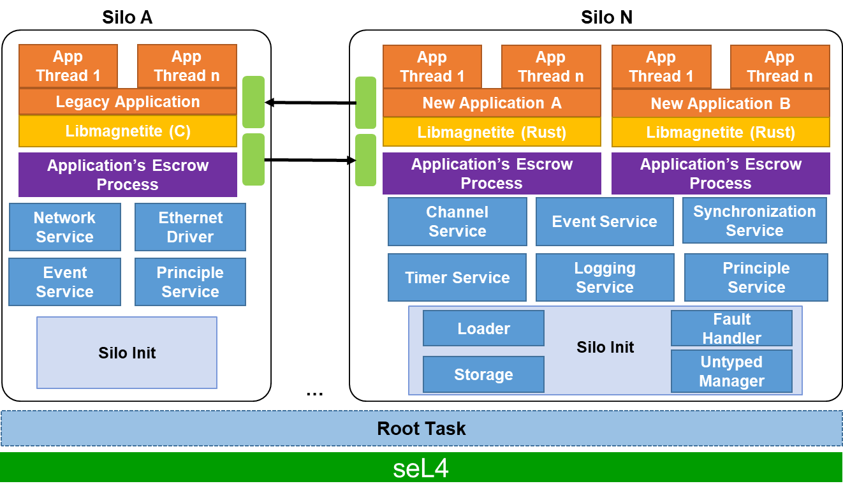
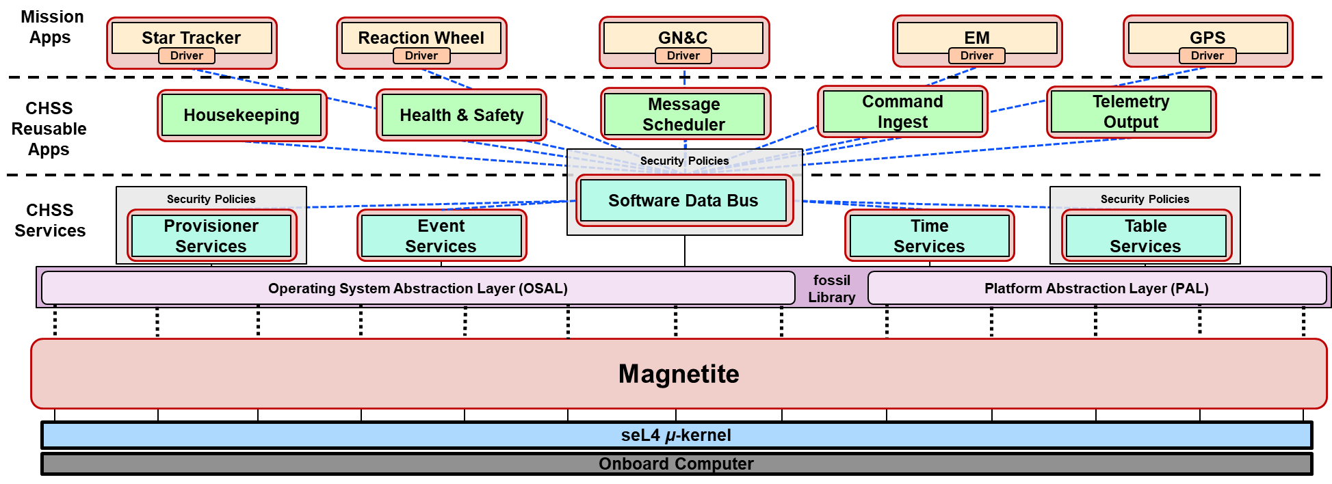
Research Direction: Isolated, Modular Systems
We’ve developed a microkernel-based operating system targeting satellites
Look for a future paper!
Based on the seL4 formally verified microkernel
Separated into 17 isolated service processes
Enough functionality to run NASA cFS
Performance on microbenchmarks similar to real-time Linux
We’ve developed a multi-process satellite flight software system
Inspired by NASA cFS’s architecture
Performant enough for a Processor-in-the-loop demonstration of GNC control
Further Research still needed!
Notes:
We have a couple research projects pushing forward this research direction. Sadly we couldn’t get papers together in time for this workshop, so look for future papers about these efforts. The first is a microkernel-based operating system aimed at satellites. This work starts with the formally verified seL4 microkernel and then builds the rest of an operating system around it using multiple user space processes. This means the operating system is composed of many isolated, modular processes, 17 of them in our case, specifically to minimize the impact of compromise. We currently have enough functionality to run NASA’s core Flight System satellite flight software. And despite performance the traditional Achilles heal of microkernels, we have similar performance to real-time Linux on microbenchmarks. Like I mentioned before, look for a future paper about this system.
Another major research project we have in this space, looks at making the flight software itself isolated and modular. Here we’re building satellite flight software loosely inspired by NASA’s cFS design. However, each “application” in the flight software is its own process, providing significantly improved isolation. This approach has been performant enough for us to demonstrate GNC control on a processor-in-the-loop testbed for an actual satellite mission.
I mention these projects not specifically to highlight the cool work we’re doing, but to emphasize that there is room for improvement in this area. We believe significant future research is needed here to fully explore the space.

Slide 12
Research Direction: Fault Recovery
How should satellite software handle attacks?
Common Solutions
Crash the system --- completely unacceptable
Log and do nothing --- timelines for manual intervention are too long
Crash a component --- maybe okay if the component isn’t critical or can be restarted
Restart --- vulnerability still exists and is still exploitable
Supply chain attacks are particularly challenging
Vulnerability and exploit may both be in the current system image
Rebooting/restarting doesn’t stop attack
Research on additional options crucially needed!
Notes:
A third research direction we see as critical for satellite security is fault recovery. We touched on this earlier, but the essential challenge here is how should satellite software handle an attack once detected? Common solutions might be to crash the system, which is completely unacceptable given satellite’s lack of accessibility and need for availability or to log and do nothing, unfortunately this isn’t really acceptable either because manual operator intervention takes a long time, especially due to limited bitrates and intermittent connectivity. Another option might be to only crash a component of the system. This might be okay so long as responses from that component can be delayed for a little bit safely and there is some other component that can restart it. Finally, we might just try to restart the whole system. Unfortunately, even in this case, the vulnerability still exists and is still exploitable so an attacker can simply retry the same attack once the system reboots, resulting in a denial of availability.
Supply chain attacks make this particularly challenging because not only the vulnerability, but even the exploit may be part of the system image. So rebooting/restarting doesn’t help. An attacker may not even have to take active work to re-exploit the vulnerability… the exploit may automatically occur when the system image starts.
Overall, none of these options are sufficient. Further research in this area is critically needed.

Slide 13
Summary
Satellite systems are increasingly under attack by malicious adversaries
Satellite software faces a number of challenges not encountered in terrestrial embedded systems
Lack of Access, Emphasis on Safety and Availability, Radiation Faults, Legacy Software
These challenges require unique solutions that require dedicated research by the security community
Important research directions to explore include:
Isolated, Modular systems
Assurance Technologies
Fault Recovery
Characterizing Radiation Faults
Interoperability with Legacy Software
Notes:
In summary, we’ve seen that satellite systems are increasingly under attack by malicious adversaries and that satellite software faces a number of challenges not seen in traditional embedded systems. These include lack of access, an emphasis on safety and availability, radiation faults, and legacy software challenges.
These challenges require unique solutions that require dedicated research by the security community. We encourage exploration of these issues by other researchers.
Finally, based on our analysis, important research directions for the future include: isolated, modular systems, assurance technologies, fault recovery, characterizing radiation faults, and interoperating with legacy software.

Slide 14
Questions?
Dr. Samuel Jero
samuel.jero@ll.mit.edu
Notes:
That concludes my presentation. I’d be happy to take any questions now.

