Slide 1


Taking a Long Look at QUIC:
An Approach for Rigorous Evaluation of Rapidly Evolving Transport Protocols
Arash Molavi Kakhki¹, Samuel Jero², David Choffnes¹, Cristina Nita-Rotaru¹, and Alan Mislove¹
¹Northeastern University
²Purdue University
IMC 2017

Slide 2



QUIC (Quick UDP Internet Connections)
Improve performance for HTTP traffic
  Reduce handshake time (0-RTT)
  Prevent head-of-line blocking
  Improve loss recovery
  Modular congestion control
  Connection migration across IPs
Avoid middlebox meddling
Protect user data
Facilitate rapid deployment
HTTP/2
HTTP/2 API
Cubic
TLS
BBR
QUIC
QUIC
1.2.3.4
TCP
UDP
No ACK ambiguity
Better RTT/BW estimation
0111
0101
IP
TCP
5.6.7.8
user space
kernel space
Notes:
QUIC stands for …
Which I am very convinced they first came up with the name QUIC, then asked a poor intern to figure out what this could be abbreviation of
QUIC is a protocol by Google, debuted in 2013
Was designed to achieve a number of goals.
First of, it was proposed to improve HTTP performance
it is meant to eventually be a general purpose transport protocol as an alternative for TCP for all types of traffic and not just for HTTP
but currently it’s mostly uses with HTTP and very integrated with it
So it this talk I am gonna stick to QUIC in HTTP context
It reduces the connection establishment time from a few RTTs for TLS over TCP to potentially 0-RTTs
It can multiplex multiple flows over the same connection without HOL bloc
It has a better loss recovery mechanism
It provides a modular plug and play CC
It allows connection migration, so for example your connections do not break if you’re phone switched between WiFi and LTE
and many other smaller hacks and optimizations
but performance was not QUIC’s only goal
Google engineers are very clear that they want to prevent modification and limit ossification of the protocol by middleboxes.
and they do that by authenticating everything and encrypting most QUIC communications
and Finally, QUIC has been designed to allow rapid experiment and deployments
and for that, it has been implemented in the userspace, as opposed to TCP which are part of the kernel which means deploying a change can take a long time, sometimes years
—————————————————————————————————
QUIC replaces most of the traditional HTTPS stack: HTTP/2, TLS, and TCP
—————————————————————————————————
QUIC uses a cryptographic handshake that minimizes handshake latency for most connections
by using known server credentials on repeat connections
and by removing redundant handshake-overhead at multiple layers in the network stack.
While network bandwidth has increased over time, the speed of light re- mains irreducible. Most connections on the Internet, and certainly most transactions on the web, are short transfers and are most impacted by this additional round trip.
eliminates head-of-line blocking delays by using a lightweight data-structuring abstraction, streams, which are multiplexed within a single connection so that loss of a single packet blocks only streams that have data in that packet.
It improves loss recovery by using unique packet numbers to avoid retransmission ambiguity and by using explicit signaling in ACKs for accurate RTT measurements.

Slide 3


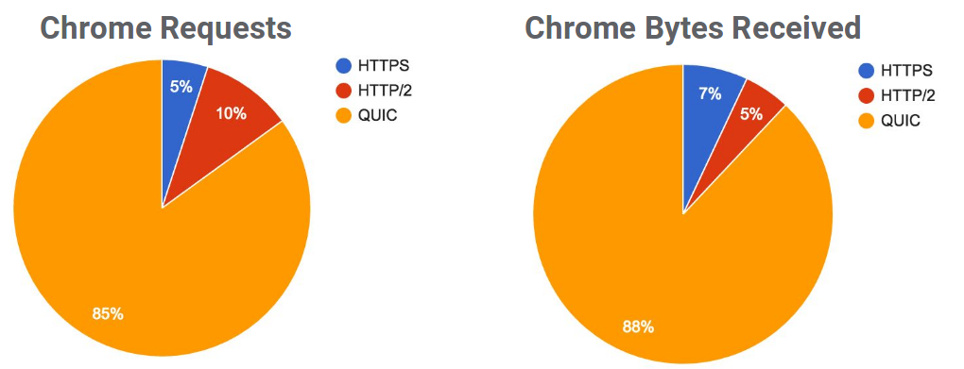



QUIC (Quick UDP Internet Connections)
Significant deployment today
  Google, Akamai
  >85% of requests from Chrome to Google use QUIC
  >7% of Total Internet Traffic
IETF standardization ongoing
  -07 drafts
  20+ implementations in progress
Google Data, from: https://www.ietf.org/proceedings/96/slides/slides-96-quic-3.pdf

Slide 4
Existing Evaluations of QUIC
Google’s evaluation
  3% page load time improvement on Google search
  8% latency reduction on Google search
  18% reduction in buffer time on YouTube
  All aggregated statistics
  Limited controlled tests
  Not reproducible
Other QUIC evaluations
        Limited environments/networks
        Limited tests
        Old versions of QUIC
        Untuned implementations
        Results not statically sound
        No root cause analysis
Notes:
Google has been using QUIC since 2013
and now more than 85% …
these statistics are very promising, but there are a number of problems here

Slide 5
Our Work
Goal: Provide a rigorous evaluation of QUIC’s performance
compared to TCP
Extensive calibration to ensure fair comparisons between QUIC and TCP
Methodology for automatic head-to-head comparisons, including root-cause-analysis
  Statistical analysis of results
Evaluation of QUIC’s performance compared to TCP
          Variety of emulated network conditions (loss, delay, jitter, …)
          Variety of network types (fixed-line, wireless, cellular, …)
          Variety of environments (desktop, mobile, …)
        Root cause analysis

Slide 6

Outline
Motivation
Methodology
Calibration
QUIC’s performance for HTTP compared with TCP
Fairness of QUIC with TCP
Summary

Slide 7





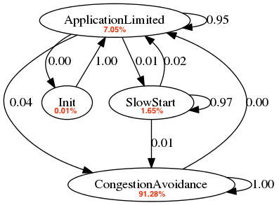
Methodology
Compare QUIC with TCP+TLS+HTTP/2 for HTTP
TCP
Ensures fair
comparison,
Provides similar
features
QUIC
Network
Primary use case
for QUIC today
TCP
Server
(Supports QUIC and TCP)
Router
(OpenWRT+TC/NETEM)
Client
Root-Cause Analysis
Instrument QUIC server to capture congestion control state machine traces to look for differences in internal behavior
QUIC (and TCP) have many components, features, and optimizations that make identifying the causes of differences very challenging
Compare
PLTs
(Page Load Times)
Simple HTML pages
isolate workload
from performance
Determine whether results are statistically significant using Welch’s t-test

Slide 8
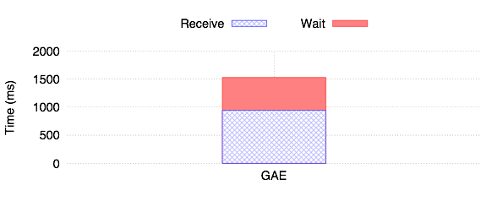
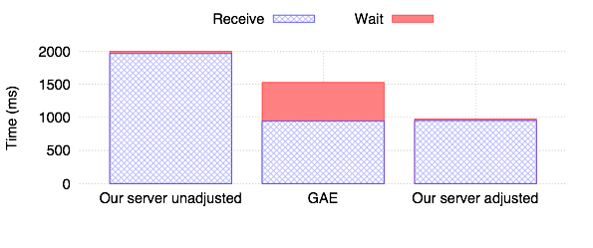
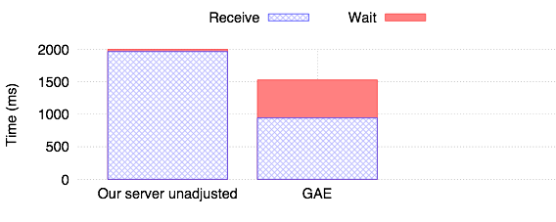
Calibration
QUIC
Network
TCP
Server
(Supports QUIC and TCP)
Server
QUIC
Router
(OpenWRT+TC/NETEM)
Client
Google Servers
  No control
Toy QUIC server in Chromium
  Not performant
Tuned toy server by:
Matching parameters with Google’s
Fixing a bug regarding slow start
Downloading a 10MB obj at 100Mbps
Notes:
Now this is great, except there is one big issue here
QUIC is experimental, and GOOGLE is the only one using it
so when it comes to QUIC servers, we can either use
1- use Google servers
2- use the toy QUIC server in Chromium
but neither of the works for our purpose
let me show you why
this plot is showing the time it take when we host our html pages on Google servers, and try to download a 10MB image.
The red portion is the time it takes from when we send out the request until we receive the first bite
and the blue part in the rest of the download.
As you can see this wait time is huge, and even worse it random
probably because there is some sort of proxy or load balancer
and this is not acceptable for our PLT tests
further, we have no control over Google servers if for example we want to change some configuration on the server
so we’re left with the toy server.
this is the same experiment when we setup our own toy server.
The random large wait time is gone, which is good
but now the receive time is much larger compare to Google servers
so we had to make the toy server as performant as Google servers
and for that, we had to extract the config that Google is using,
some of which require gray box testing
and after some tuning, and fixing a bug in chromium source, we got this
Now we have a tuned and performant server
and this is extremely important because not of the prior work went through this step
and reported poor performance for QUIC, which we know it’s exactly because of not tuning the server

Slide 9
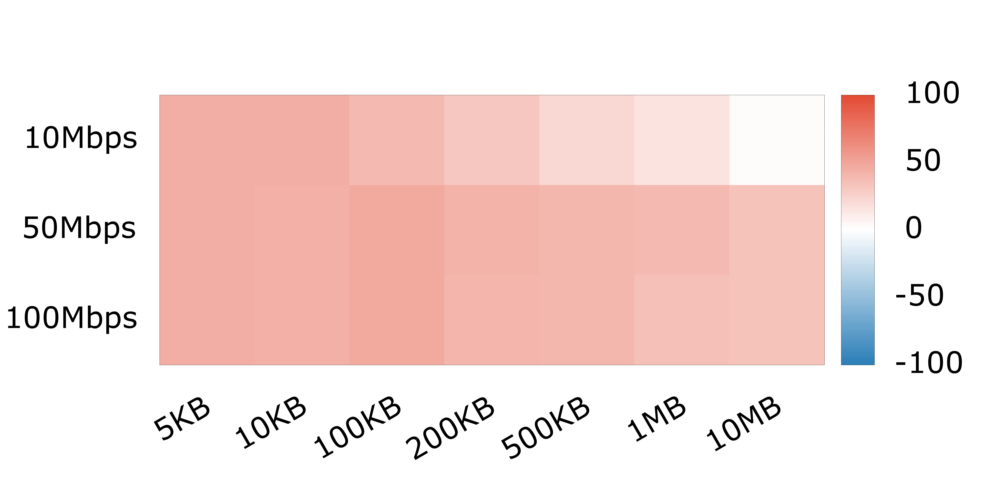
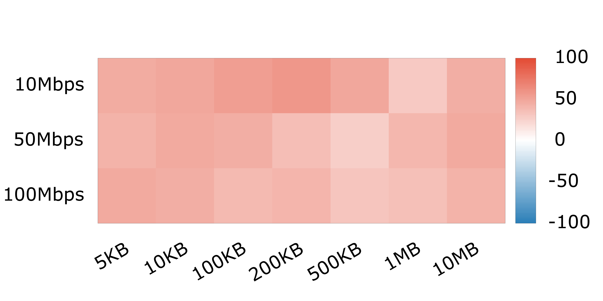

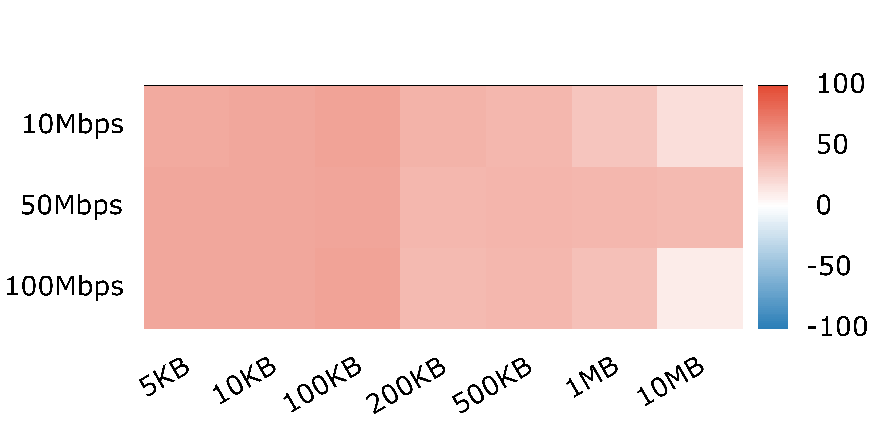
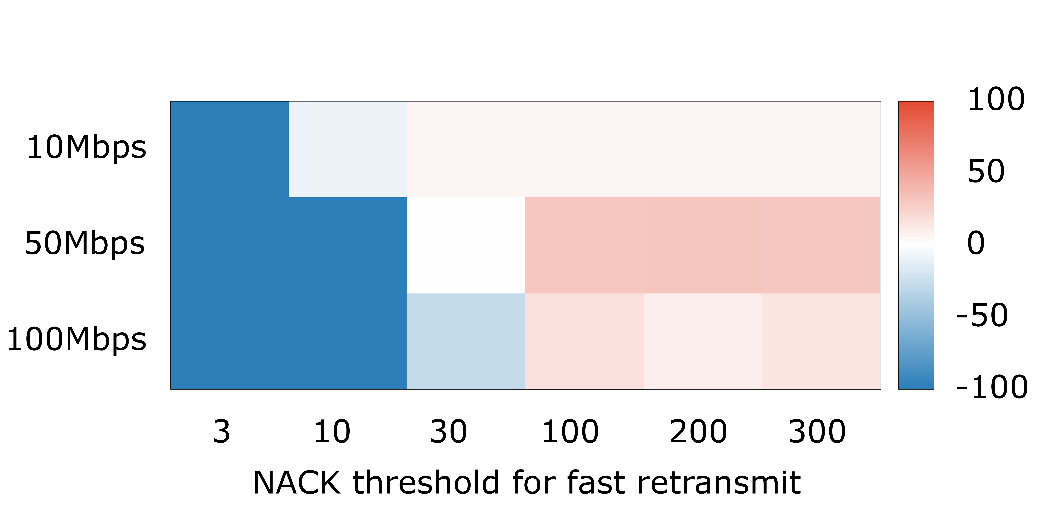
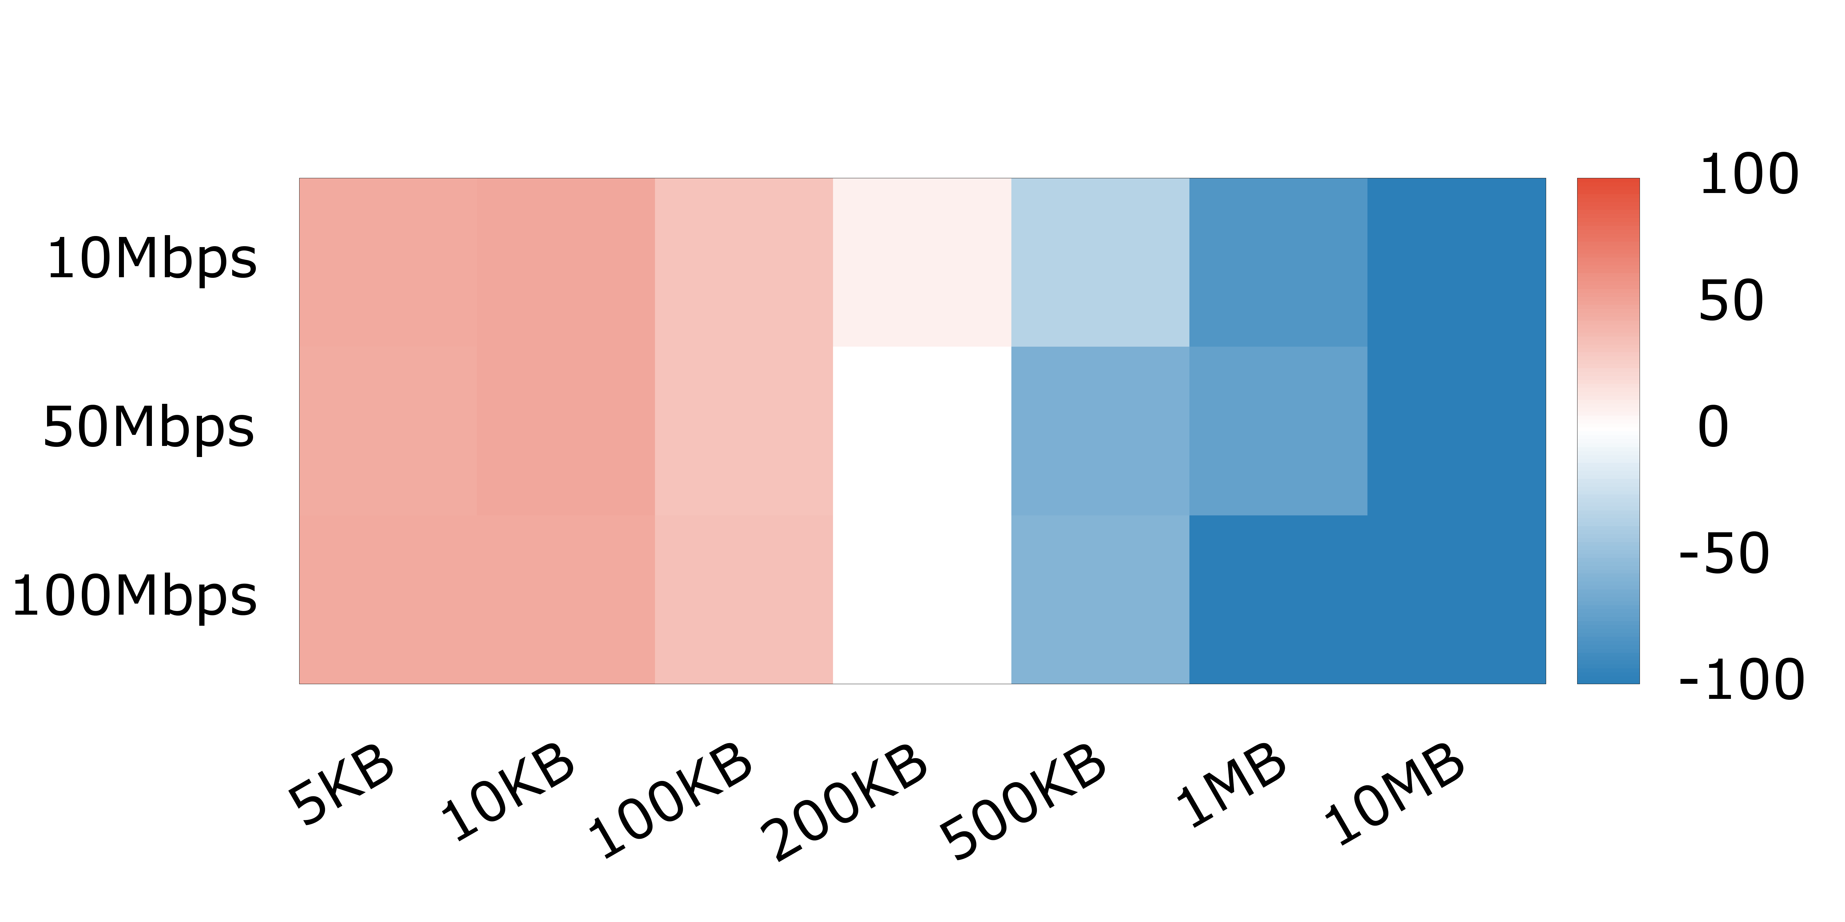
HTTP Performance: QUIC vs TCP
RTT = 36ms, loss = 0%
QUIC is faster
RTT = 36ms, loss = 1%
44%
45%
44%
Bandwidth
QUIC
Network
TCP is faster
RTT = 112ms, loss = 0%
Object Size
TCP
Our server on EC2
(Support QUIC and TCP)
Router
(OpenWRT+TC/NETEM)
Client
RTT = 112ms with re-ordering, loss = 0%
RTT = 112ms with re-ordering, loss = 0%
QUIC performs better than TCP, except under reordering, but improvements diminish with transfer size
Notes:
Ok. So we took our testbed and tuned server, and did some HTTP PLT tests
let’s start with desktop environment
and see how QUIC and TCP compare when downloading different object sizes
at different bottleneck BW
I’m gonna show the page load time difference of the two protocol in percentage
So for example when downloading a 5KB object, QUIC improves the DL time by about 45%
Now to avoid bombarding you with numbers and make things easier to read,
I am gonna turn these numbers into heatmaps
where red means QUIC is doing better,
blue means TCP is doing better
and white means there is no significant difference between the two
and this is the heatmap for different object sized at different BW when RTT is 36ms and loss is 0%
This is the same test, but under 1% loss, again QUIC is doing better due to it’s better loss detection and recovery mechanism compare to TCP
we increased the RTT, still QUIC outperforming TCP
and finally we compared the two protocols in presence of packet re-ordering, and there are suddenly some very blue cells
to see why this is happening, we looked at TCP code and also instrumented QUIC,
and realized when packets are reordered,
QUIC falsely thinks they’ve been lost!
whereas TCP detect packet reordering and avoids false loss detections by increasing it’s NACK threshold
to see if QUIC can benefit from the same mechanism that TCP has for increasing the NACK
we tested QUIC with different NACK threshold
if we look at the case downloading a 10MB object
with the default NACK threshold of 3, QUIC is doing much worse than TCP in presence of packet reordering
but as we increase that threshold, QUIC’s performance improves and those blue cells turn into red
we have been in touch with QUIC engineers at Google regarding this issue, and they told us they are actually working on solutions that can handle packet re-ordering

Slide 10

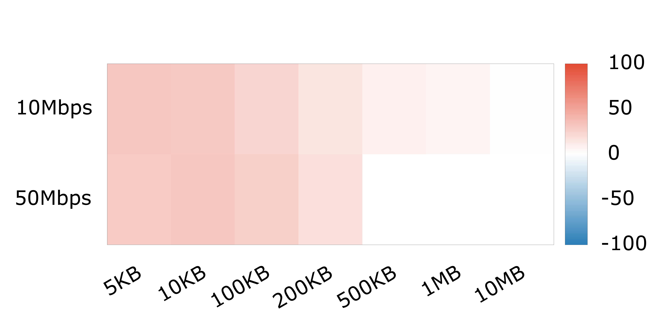
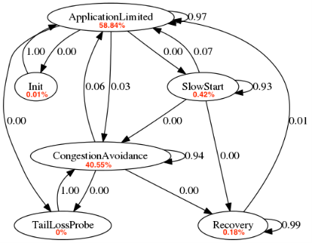

HTTP Performance: QUIC vs TCP
% of time spent in each state
Slow Start | Cong. Avoid. | App. Limit. | Recovery
1.7% | 91.5% | 7.1% | 0%
0.42% | 40.6% | 58.8% | 0.2%
RTT = 36ms, loss = 0%
WIFI
RTT = 36ms, loss = 0%
Resource constraints limit mobile performance
Notes:
ok, these results showed QUIC does mostly better than TCP on a computer
but what about mobile devices?
let’s look at the simple low latency and loss case.
we redid this using a mobile phone, and we found this
QUIC is still doing better, but the gains have diminished, hence less red cells
To find out why this is the case, we instrument the QUIC’s congestion control to generate state machine diagrams
so if i take the 10MB example again, the congestion control state machines for mobile and desktop look like this
they show what fraction of time was spent in each states and the transition probabilities
Now it’s a bit difficult to compare state machines like this,
but if I put them in the form of a table, things become much more clear
this table is showing what percentage of time was spent in each state for the same test on a laptop and a mobile phone
when using a phone QUIC spends most of it’s time in application limited state,
That means the client is not able to process the data fast enough and the sender needs to slow down
while for the same conditions, this number is only 7% on a laptop
and this is the cost of implementing QUIC in application layer. It does fine on a powerful device like a laptop,
but on a more resource-constraint phone the benefits diminish

Slide 11
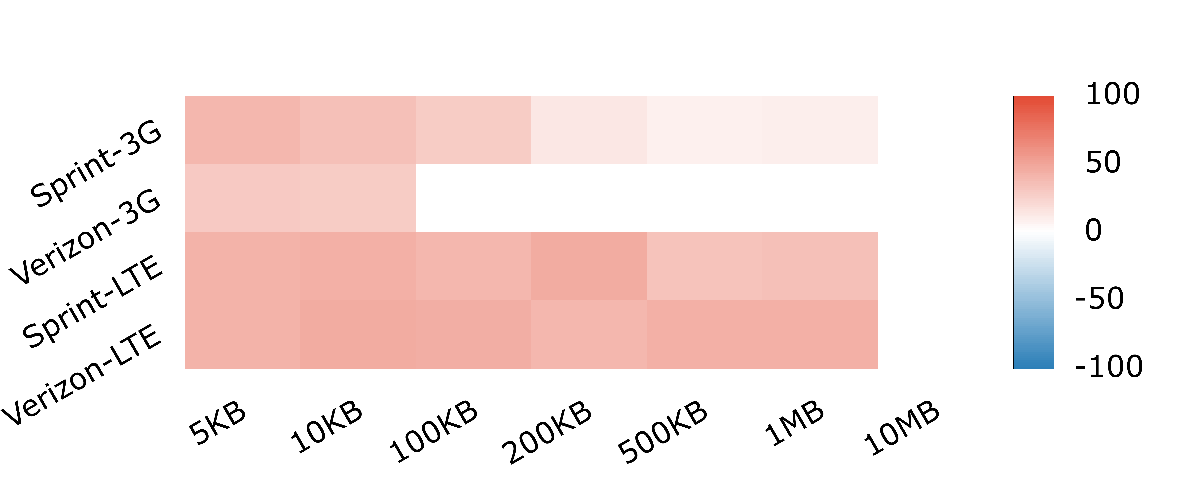
HTTP Performance: QUIC vs TCP
Cellular
QUIC for 3G:
+ Lower bandwidth, higher loss
- Higher reordering
QUIC performs better than TCP in cellular networks, but limited by reordering

Slide 12
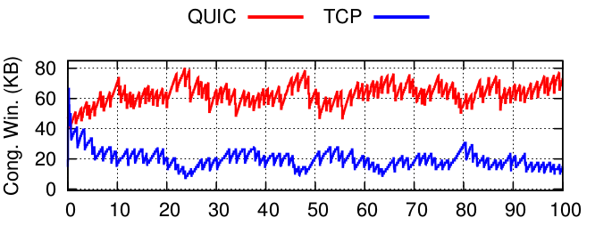
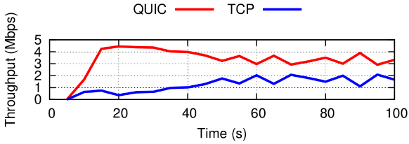
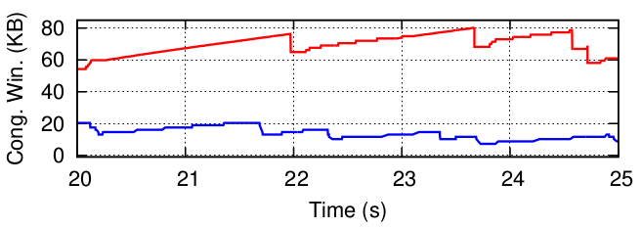
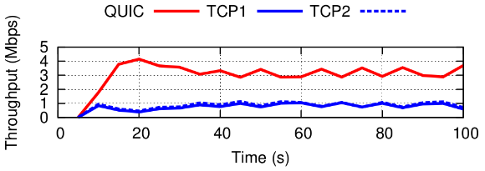
Fairness: QUIC vs TCP
A property of transport protocols that ensures that a flow does not consume more than its fair share of bottleneck bandwidth
5Mbps bottleneck link, RTT=36ms, buffer=30 KB
 | Flow | Avg. Tput
QUIC vs. TCP | QUIC TCP | 2.71 1.62
QUIC vs. TCPx2 | QUIC avg(TCP) | 2.8 0.83
QUIC vs. TCPx4 | QUIC avg(TCP) | 2.75 0.41
Not Responsible:
TCP Segment Offload
Delayed ACKs
RTT estimation
Investigation still in progress
QUIC is very unfair to TCP, despite both using CUBIC
Notes:
ok. one last thing I want to talk about QUIC it’s fairness
Fairness is very important and
if flows and protocols are not fair to each other
we have an internet that performances are vastly more variable
and possibly some applications that just get shut out by others
So QUIC’s fairness is definitely something that can improve

Slide 13
Summary
Evaluated the performance of QUIC, an application-layer transport protocol that is rapidly evolving and deployed at scale
Focus on the performance and fairness of QUIC for HTTP in comparison to TCP+TLS+HTTP/2
  Under a variety of network conditions
  In desktop, mobile, and cellular environments
  With careful calibration
  Ensuring statistical significance
Root-cause analysis to understand our findings by instrumenting the QUIC implementation
Approach can be applied to future versions and protocols
Notes:
to recap, we evaluate a protocol that is changing rapidly with out public configuration parameters
we carefully calibrated QUIC, an important step missing in previous work
and conducted controlled experiments
and by instrumenting the protocol we
inferred state machines
provided root cause analysis
narrowed down some limitation and proposed some fixes
And all of this can be applied to future versions of QUIC as they are rolled out
or other flavors of TCP
or even other protocols

Slide 14
Questions?
Samuel Jero
sjero@sjero.net
Check out the code! http://quic.ccs.neu.edu

